Slide 1
OPTIMIZATION
MGCR 293
Dr. K. Salmasi
Dr. Taweewan Sidthidet
Dr. Tariq Nizami
T.A.: Mike Brintnell
Presentation Credit: Brianna Mooney

Slide 2
CHAPTER REVIEW

Slide 3
Functions
A function is a relationship between two variables: y (dependent) and x (independent)
We use functions to model relationships in Managerial Economics, the most common are demand functions and production functions

Slide 4
MARGINAL VALUE
The Marginal value of a dependent variable is the change in this dependent variable associated with a 1-unit change in a particular independent variable
If we isolate Qd in our demand function (ie: Qd is the dependent variable) the marginal value of Qd is the change in Qd associated with a 1-unit change in price (the independent variable)
The dependent variable is maximized when the marginal value shifts from positive to negative
As long as the marginal value is greater than zero, then increasing the independent variable will yield a larger value for the dependent variable. You keep increasing the value of the independent variable just until you have reached the point where any further increase in price would cause Qd to decrease.

Slide 5
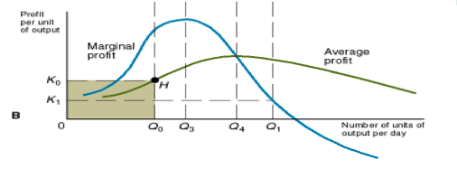
MARGINAL PROFIT & AVERAGE PROFIT
Marginal profit is the change in profit associated with a 1-unit change in total output
When total profit is maximized, the slope of the profit function is 0
Average profit rises if it is less than marginal profit
Average profit falls if it is greater than marginal profit
The point where average profit intersects marginal profit is the point at which average profit is maximized (Avg. profit = marginal profit)

Slide 6
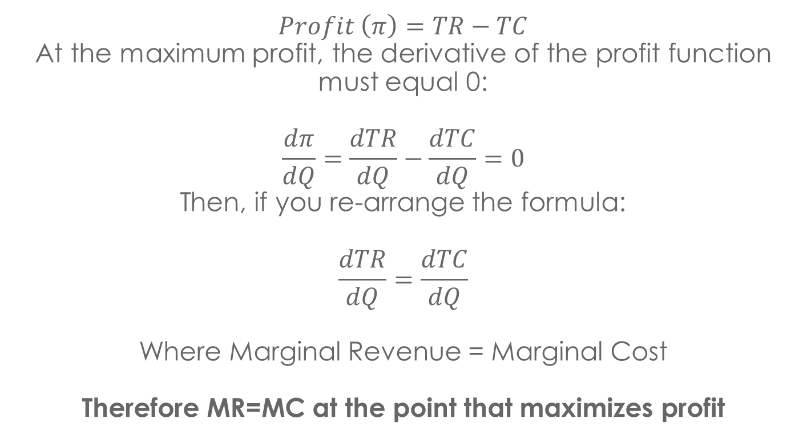
PROFIT-MAXIMIZING RULE:
$$Profit \left(π\right)=TR−TC$$
At the maximum profit, the derivative of the profit function must equal 0:
$$\frac{dπ}{dQ}=\frac{dTR}{dQ}−\frac{dTC}{dQ}=0$$
Then, if you re-arrange the formula:
$$\frac{dTR}{dQ}=\frac{dTC}{dQ}$$
Where Marginal Revenue = Marginal Cost
Therefore MR=MC at the point that maximizes profit

Slide 7
MARGINAL PROFIT DECISION RULES
MR > MC : activity should be increased
MR = MC: profit is maximized
MR < MC: activity should be decreased

Slide 8
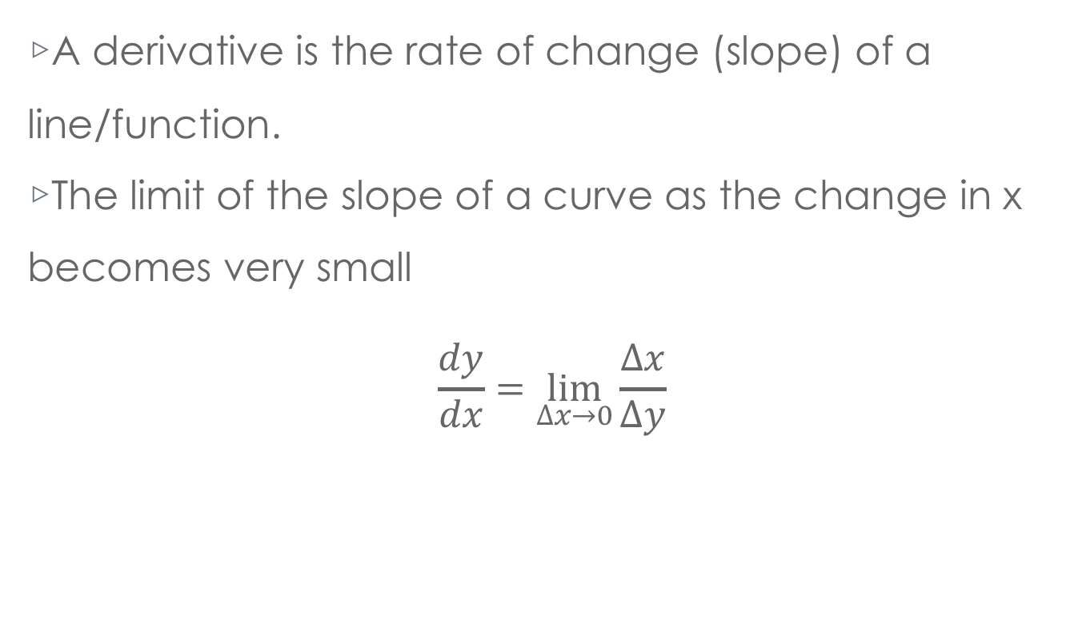
DERIVATIVES
A derivative is the rate of change (slope) of a line/function.
The limit of the slope of a curve as the change in x becomes very small
$$\frac{dy}{dx}=\lim_{∆x→0}{\frac{∆x}{∆y}}$$

Slide 9


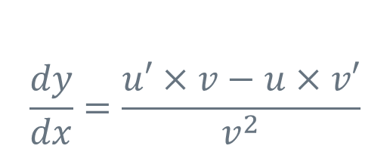
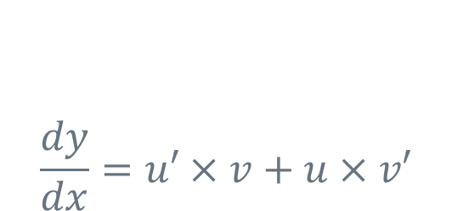
Derivative Rules
$\frac{dY}{dx}$ = 0
Derivative of a Constant Rule:
Suppose Y = a, where is a constant
The Power Rule:
Suppose Y = ax^{b}, where is a and b are constants and x is a variable
$$\frac{dY}{dx}={bax}^{b−1}$$
$$\frac{dy}{dx}=u′×v+u×v′$$
The Product Rule:
Suppose V = ax^{b} and U = nx^{c} where a, b, n and c are all constants and x is a variable.
Suppose Y = V x U
The Quotient Rule:
$$\frac{dy}{dx}=\frac{u′×v−u×v′}{v^{2}}$$
Suppose V = ax^{b} and U = nx^{c} where a, b, n and c are all constants and x is a variable.
Suppose Y = U / V

Slide 10
OPTIMIZATION
Optimization is the process of maximizing or minimizing a function, with or without certain constraints
Steps:
Take the first derivative of a function
Set the first derivative function equal to zero
Solve the function for the “x” value that makes the derivative equal to zero. The original function will either be maximized or minimized at that “x” value
Take the second derivative
Substitute the “x” value into the second derivative. If the second derivative is positive at that “x” value, then the original function is minimized at that “x” value. Conversely, if the second derivative is negative at that “x” value, then the original function is maximized at that “x” value.

Slide 11
OPTIMIZATION EXAMPLE
Suppose y = x + x²
Step 1: First Derivative: y’ = 2x + 1
Step 2: 0 = 2x +1
Step 3: x = -1/2
Step 4: Second Derivative y’’ = 2
Step 5: Since y’’ = 2 is always positive, y = x + x² must
be minimized at x = -1/2

Slide 12
CONSTRAINED OPTIMIZATION
To optimize a function given a single constraint, imbed the constraint in the function and optimize as previously defined.
This means that, before taking the first derivative, simply merge the constraint function into the original function to make a “combined” function.
Examples will be shown in end of chapter problems and additional resources.

Slide 13
HOMEWORK SOLUTIONS

Slide 14
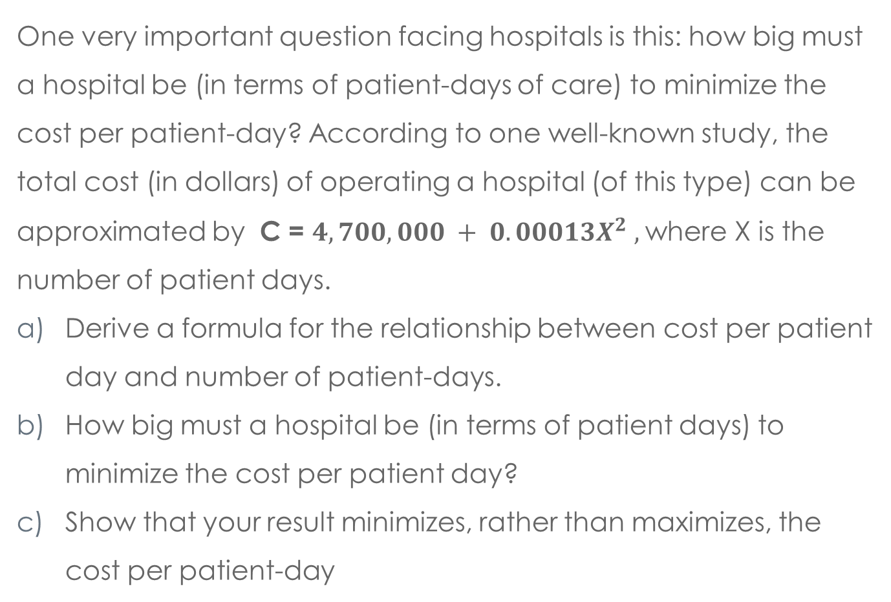
QUESTION 1
One very important question facing hospitals is this: how big must a hospital be (in terms of patient-days of care) to minimize the cost per patient-day? According to one well-known study, the total cost (in dollars) of operating a hospital (of this type) can be approximated by C = $4,700,000 + 0.00013X^{2} ,$where X is the number of patient days.
Derive a formula for the relationship between cost per patient day and number of patient-days.
How big must a hospital be (in terms of patient days) to minimize the cost per patient day?
Show that your result minimizes, rather than maximizes, the cost per patient-day

Slide 15
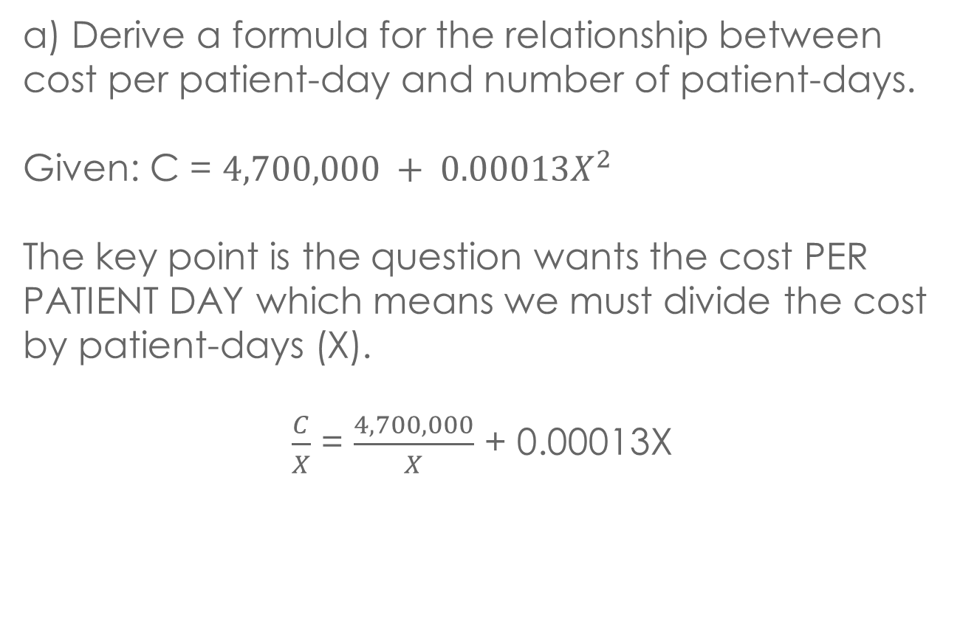
SOLUTION 1a
a) Derive a formula for the relationship between cost per patient-day and number of patient-days.
Given: C = $4,700,000 + 0.00013X^{2}$
The key point is the question wants the cost PER PATIENT DAY which means we must divide the cost by patient-days (X).
$\frac{C}{X}$ = $\frac{4,700,000}{X}$ + 0.00013X

Slide 16
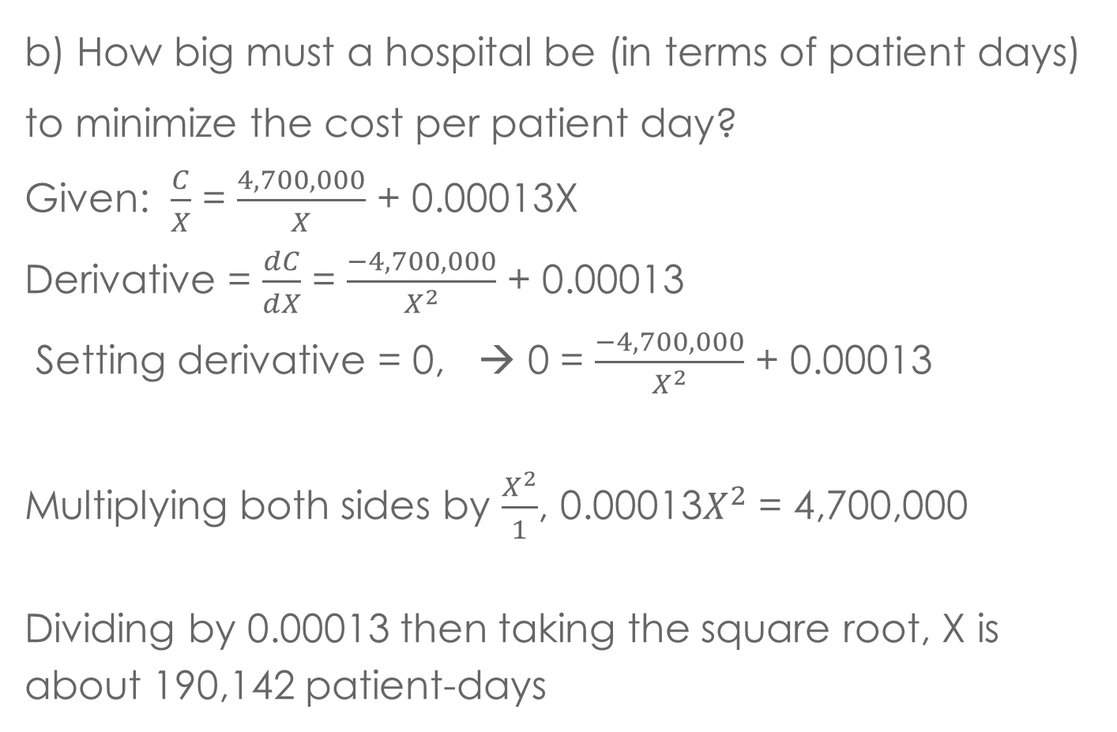
SOLUTION 1b
b) How big must a hospital be (in terms of patient days) to minimize the cost per patient day?
Given: $\frac{C}{X}$ = $\frac{4,700,000}{X}$ + 0.00013X
Derivative = $\frac{dC}{dX}$ = $\frac{−4,700,000}{X^{2}}$ + 0.00013
Setting derivative = 0, → 0 = $\frac{−4,700,000}{X^{2}}$ + 0.00013
Multiplying both sides by $\frac{X^{2}}{1}$, 0.00013$X^{2}$ = 4,700,000
Dividing by 0.00013 then taking the square root, X is about 190,142 patient-days

Slide 17
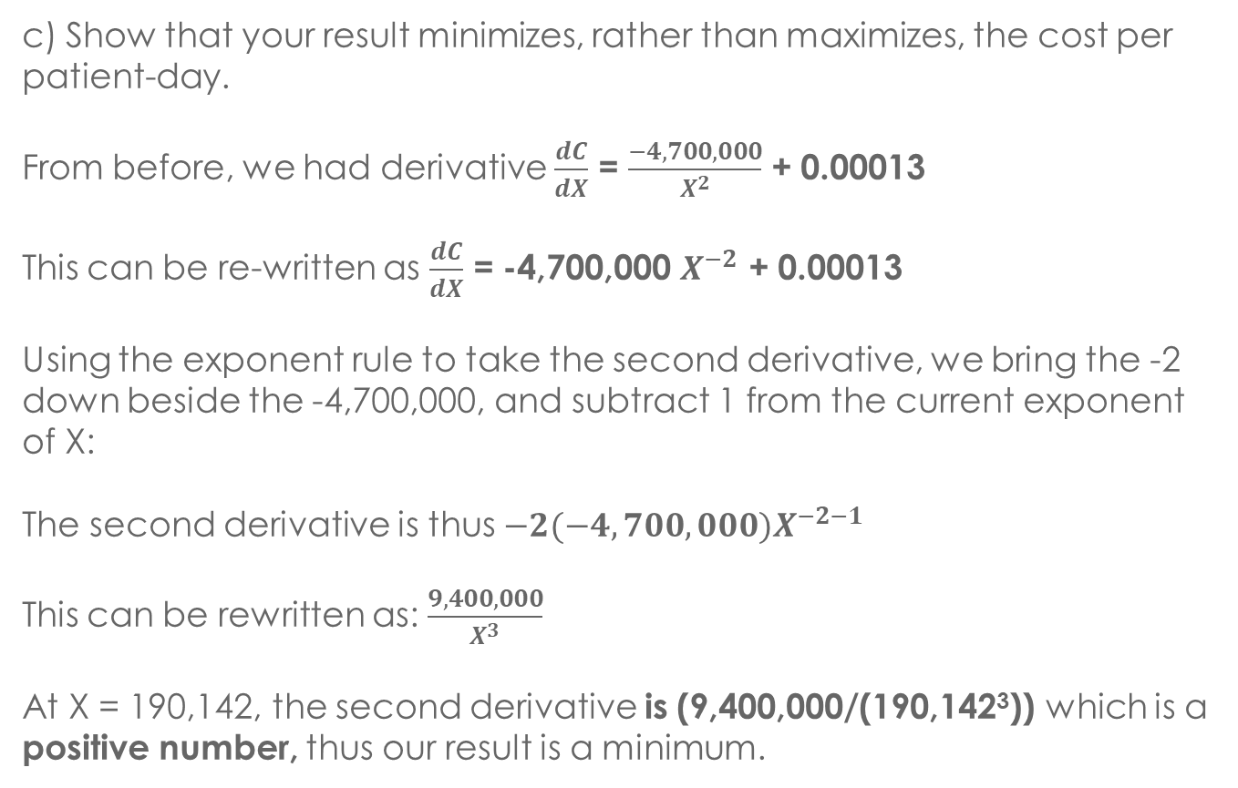
SOLUTION 1c
c) Show that your result minimizes, rather than maximizes, the cost per patient-day.
From before, we had derivative $\frac{dC}{dX}$ = $\frac{−4,700,000}{X^{2}}$ + 0.00013
This can be re-written as $\frac{dC}{dX}$ = -4,700,000 $X^{−2}$ + 0.00013
Using the exponent rule to take the second derivative, we bring the -2 down beside the -4,700,000, and subtract 1 from the current exponent of X:
The second derivative is thus $−2(−4,700,000)X^{−2−1}$
This can be rewritten as: $\frac{9,400,000}{X^{3}}$
At X = 190,142, the second derivative is (9,400,000/(190,142³)) which is a positive number, thus our result is a minimum.

Slide 18
QUESTION 2
The Trumbull company has developed a new product. Trumbull’s chairperson estimates that the new product will increase the firm’s revenues by $5 million per year, and that it will result in extra out-of-pocket costs of $4 million per year, the fully allocated costs (including a percentage of overhead, depreciation, and insurance) being $5.5 million.

Slide 19
QUESTION 2
Trumbull’s chairperson feels that it would not be profitable to introduce this new product. Is the chairperson right? Why or why not?
Trumbull’s vice president for research argues that since the development of this product has already cost about $10 million, the firm has little choice but to introduce it. Is the vice president right? Why or why not?

Slide 20
SOLUTION 2a
Given: $5 million revenue, 4$ million cost, $5.5 million allocated costs
Since the allocated costs (such as overhead) would be incurred either way, we must ignore it and compare $5 million in revenue to $4 million cost, resulting in a $1 million profit. Thus, the chairperson is wrong and they should introduce this product, as it is clearly profitable.

Slide 21
SOLUTION 2b
Given: The development of the product has already cost $10 million
The $10 million is referred to as “sunk” and is irrelevant. Either way the company lost those 10 million, so the only thing that matters is whether their future revenue will be greater than their future cost.

Slide 22
QUESTION 3
For the Martin Corporation, the relationship between profit and output is the following:
Output (number of units per day) | Profit (millions of dollars per day)
0 | -10
1 | -8
2 | -5
3 | 0
4 | 2
5 | 7
6 | 12
7 | 21
8 | 22
9 | 23
10 | 20

Slide 23
QUESTION 3
What is the marginal profit when output is between 5 and 6 unit per day? When output is between 9 and 10 units per day?
At what output is average profit a maximum?
Should the Martin Corporation produce the output where average profit is a maximum? Why or why not?

Slide 24
SOLUTION 3a
Given: At 5 units profit is 7, at 6 units profit is 12, at 9 units profit is 23, at 10 units profit is 20
Marginal profit of increasing output by 1 unit from 5 units is Profit(6) – Profit (5) = 12 – 7 = 5 (in thousands of dollars/day)
Marginal profit of increasing output by 1 unit from 9 units is Profit(10)-Profit(9) = 20 – 23 = -3 (in thousands of dollars/day)

Slide 25
SOLUTION 3b
Average Profit = Total Profit / Output
Calculating this for every output level, you will find the maximum average profit at output of 7 units with profit of 21, so 21/7 = $3 (in thousands).
All other average profits fall below this level.

Slide 26
SOLUTION 3c
No, they should produce where total profit is maximized (in this case, an output of 9). Maximum profit is $23 (in thousands).

Slide 27
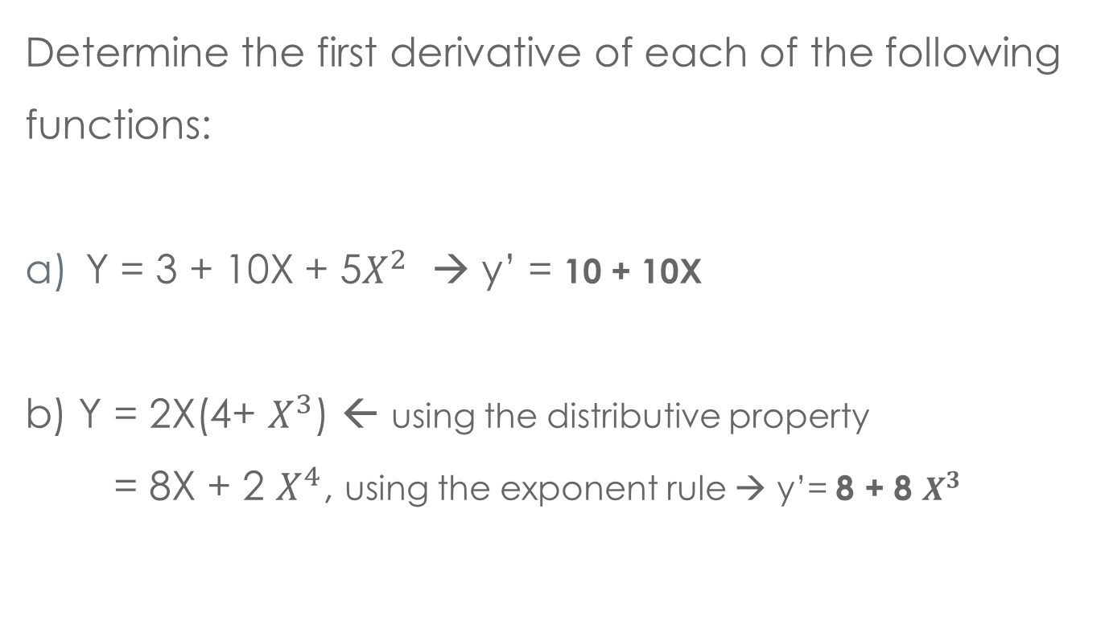
QUESTION / SOLUTION 4
Determine the first derivative of each of the following functions:
Y = 3 + 10X + 5$X^{2}$ → y’ = 10 + 10X
b) Y = 2X(4+ $X^{3}$) ← using the distributive property
= 8X + 2 $X^{4}$, using the exponent rule → y’= 8 + 8 $X^{3}$

Slide 28
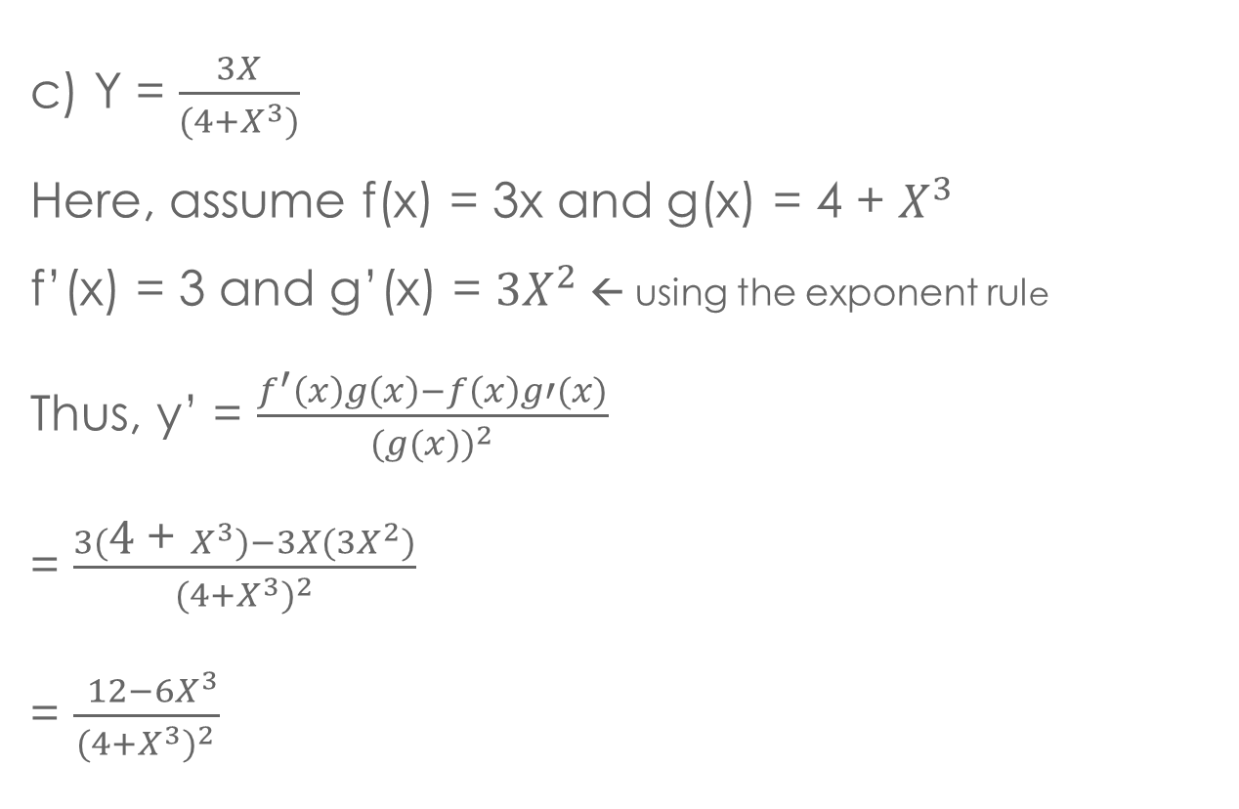
QUESTION / SOLUTION 4
c) Y = $\frac{3X}{(4+X^{3})}$
Here, assume f(x) = 3x and g(x) = 4 + $X^{3}$
f’(x) = 3 and g’(x) = ${3X}^{2}$← using the exponent rule
Thus, y’ = $\frac{f^{′}\left(x\right)g\left(x\right)−f\left(x\right)g′(x)}{{(g(x))}^{2}}$
= $\frac{3(\text{4 }\text{+ }X^{3})−3X({3X}^{2})}{{(4+X^{3})}^{2}}$
= $\frac{ {12−6X}^{3}}{{(4+X^{3})}^{2}}$

Slide 29

QUESTION / SOLUTION 4d
d) Y = $\frac{4X}{(X−3)}$
Again, we use the quotient rule with f(x) = 4x, g(x) = x-3
f’(x) = 4 and g’(x) = 1
Thus, derivative = $\frac{4(X−3)−4X(1)}{{(X−3)}^{2}}$
= $\frac{−12}{{(X−3)}^{2}}$

Slide 30
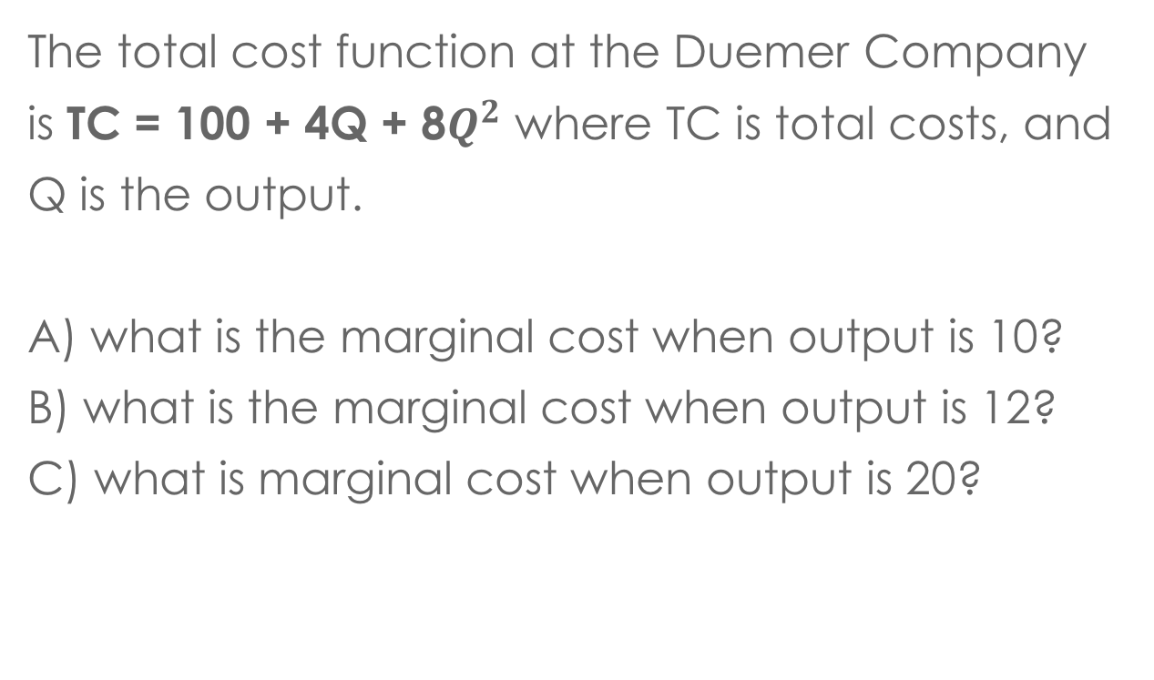
QUESTION 5
The total cost function at the Duemer Company is TC = 100 + 4Q + 8$Q^{2}$ where TC is total costs, and Q is the output.
A) what is the marginal cost when output is 10?
B) what is the marginal cost when output is 12?
C) what is marginal cost when output is 20?

Slide 31

SOLUTION 5
Given:
TC = 100 + 4Q + 8 $Q^{2}$
MC = $\frac{dTC}{dQ}$= 4 + 16Q ← using exponent rule
A) 4 + 16(10) = 164
B) 4 + 16(12) = 196
C) 4 + 16(20) = 324

Slide 32
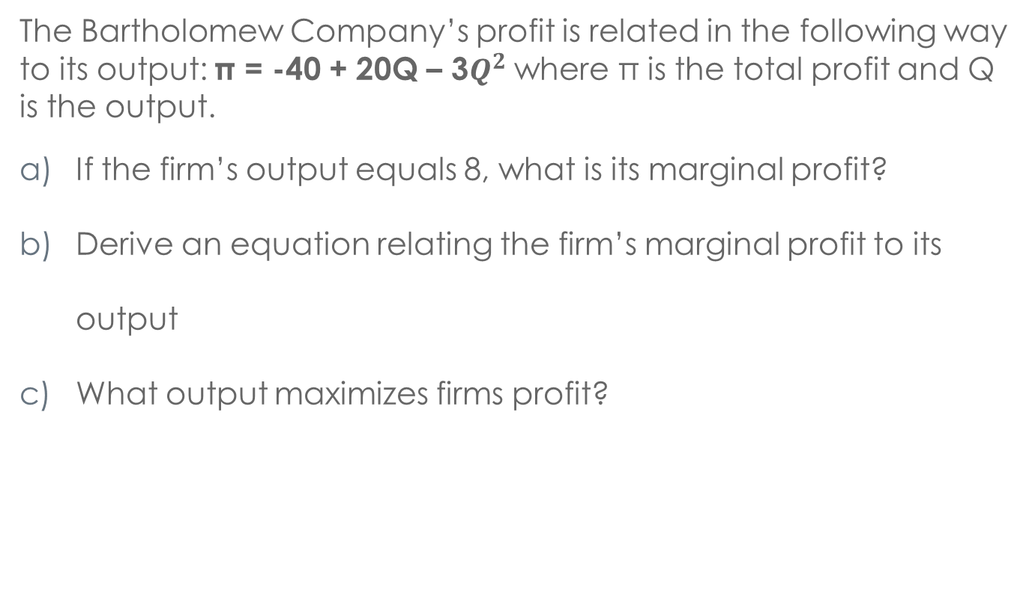
QUESTION 6
The Bartholomew Company’s profit is related in the following way to its output: π = -40 + 20Q – 3$Q^{2}$ where π is the total profit and Q is the output.
If the firm’s output equals 8, what is its marginal profit?
Derive an equation relating the firm’s marginal profit to its output
What output maximizes firms profit?

Slide 33

SOLUTION 6
MP = $\frac{dπ}{dQ}$ = 20 – 6Q , at quantity 8, MP = 20 – 6(8) = -28
This was done above → MP = $\frac{dπ}{dQ}$ = 20 – 6Q
Set MP = 0 → 20-6Q = 0 → 6Q = 20 → Q = 3.33 units

Slide 34
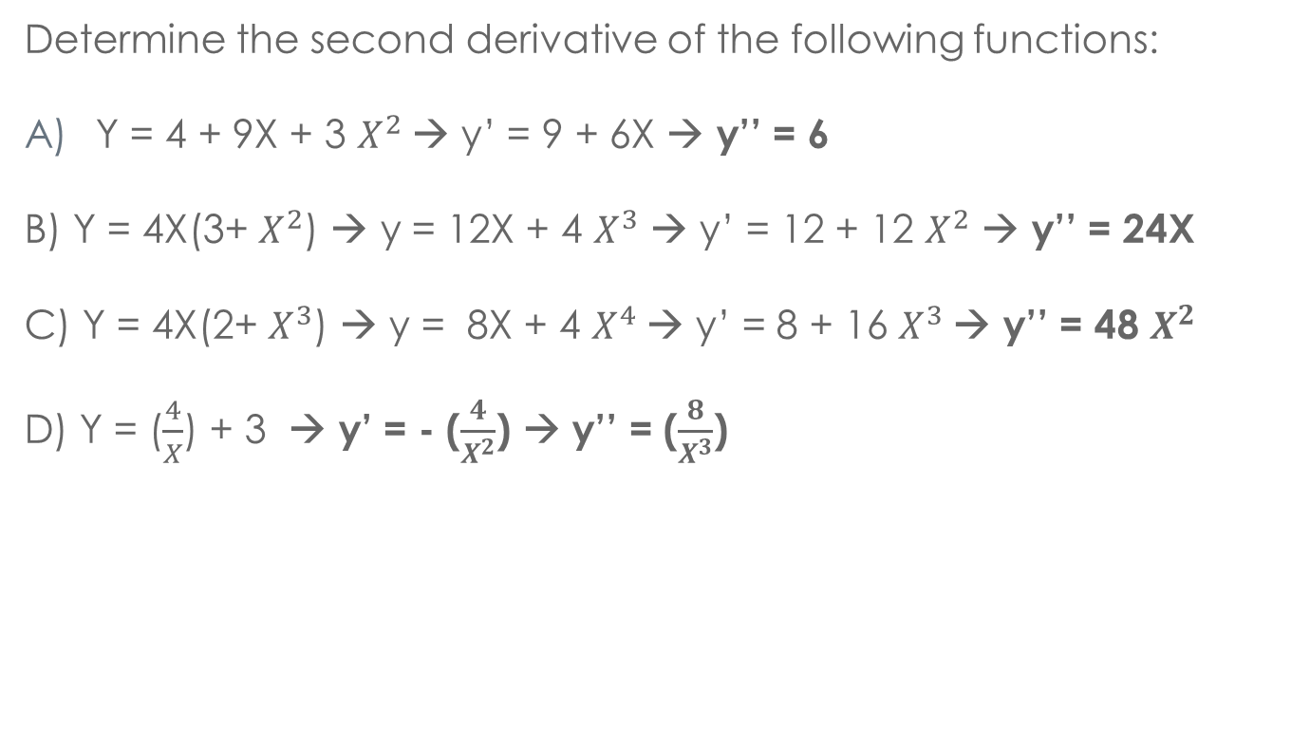
QUESTION 7
Determine the second derivative of the following functions:
Y = 4 + 9X + 3 $X^{2}$→ y’ = 9 + 6X → y’’ = 6
B) Y = 4X(3+ $X^{2}$) → y = 12X + 4 $X^{3}$ → y’ = 12 + 12 $X^{2}$ → y’’ = 24X
C) Y = 4X(2+ $X^{3}$) → y = 8X + 4 $X^{4}$→ y’ = 8 + 16 $X^{3}$→ y’’ = 48 $X^{2}$
D) Y = ($\frac{4}{X}$) + 3 → y’ = - ($\frac{4}{X^{2}}$) → y’’ = ($\frac{8}{X^{3}}$)

Slide 35
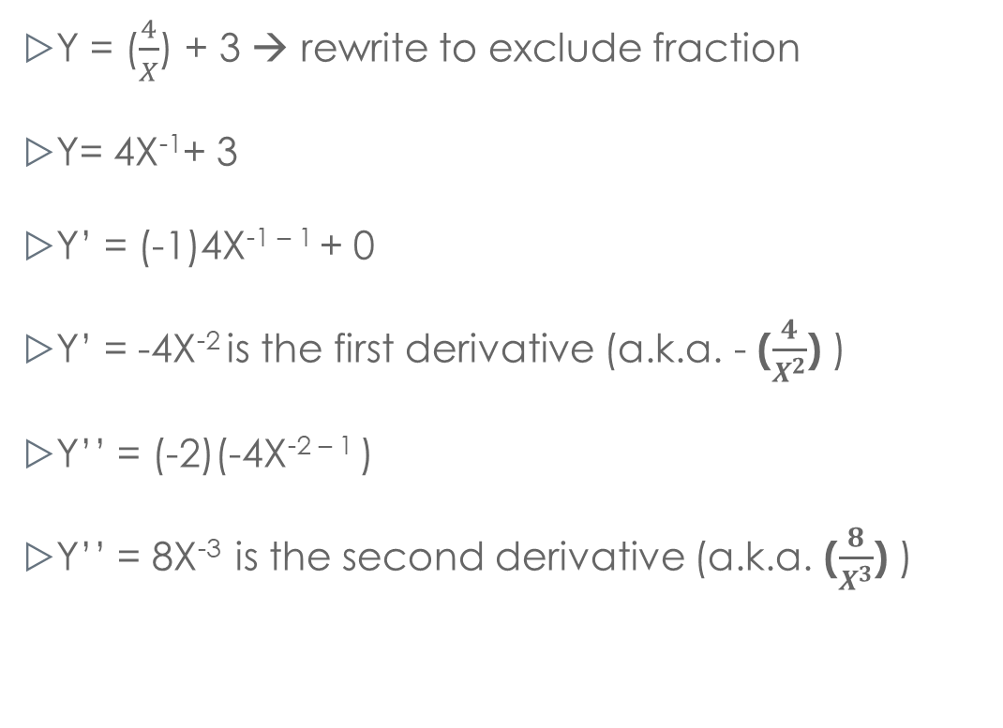
SOLUTION 7d Cont’d
Y = ($\frac{4}{X}$) + 3 → rewrite to exclude fraction
Y= 4X⁻¹+ 3
Y’ = (-1)4X^{-1 – 1} + 0
Y’ = -4X⁻² is the first derivative (a.k.a. - ($\frac{4}{X^{2}}$) )
Y’’ = (-2)(-4X^{-2 – 1} )
Y’’ = 8X⁻³ is the second derivative (a.k.a. ($\frac{8}{X^{3}}$) )

Slide 36
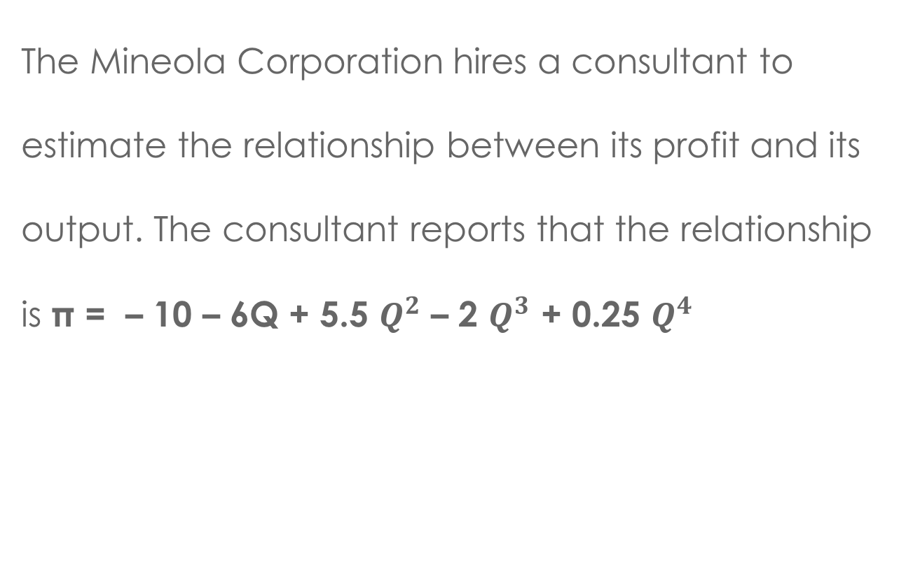
QUESTION 8
The Mineola Corporation hires a consultant to estimate the relationship between its profit and its output. The consultant reports that the relationship is π = – 10 – 6Q + 5.5 $Q^{2}$ – 2 $Q^{3}$ + 0.25 $Q^{4}$

Slide 37
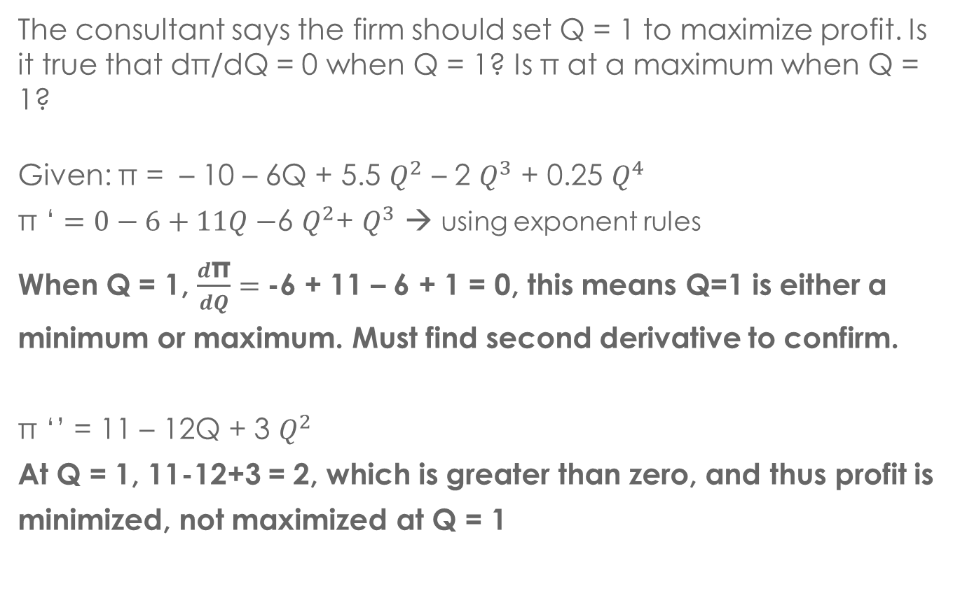
QUESTION / SOLUTION 8a
The consultant says the firm should set Q = 1 to maximize profit. Is it true that dπ/dQ = 0 when Q = 1? Is π at a maximum when Q = 1?
Given: π = – 10 – 6Q + 5.5 $Q^{2}$ – 2 $Q^{3}$ + 0.25 $Q^{4}$
π ‘ $=0−6+11Q−$6 $Q^{2}$+ $Q^{3}$ → using exponent rules
When Q = 1, $\frac{d\text{π}}{dQ}=$-6 + 11 – 6 + 1 = 0, this means Q=1 is either a minimum or maximum. Must find second derivative to confirm.
π ‘’ = 11 – 12Q + 3 $Q^{2}$
At Q = 1, 11-12+3 = 2, which is greater than zero, and thus profit is minimized, not maximized at Q = 1

Slide 38
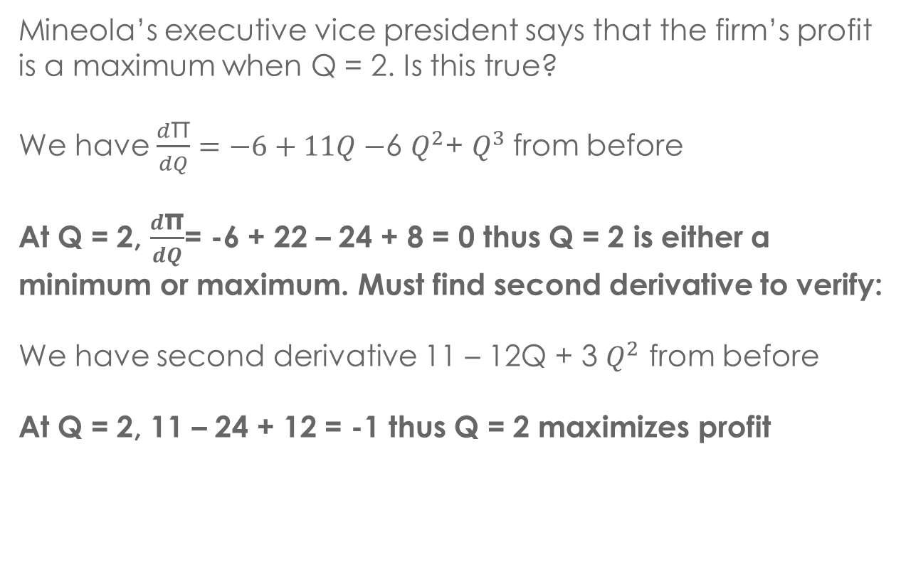
QUESTION / SOLUTION 8b
Mineola’s executive vice president says that the firm’s profit is a maximum when Q = 2. Is this true?
We have $\frac{d\text{π}}{dQ}=−6+11Q−$6 $Q^{2}$+ $Q^{3}$from before
At Q = 2, $\frac{d\text{π}}{dQ}$= -6 + 22 – 24 + 8 = 0 thus Q = 2 is either a minimum or maximum. Must find second derivative to verify:
We have second derivative 11 – 12Q + 3 $Q^{2}$ from before
At Q = 2, 11 – 24 + 12 = -1 thus Q = 2 maximizes profit

Slide 39
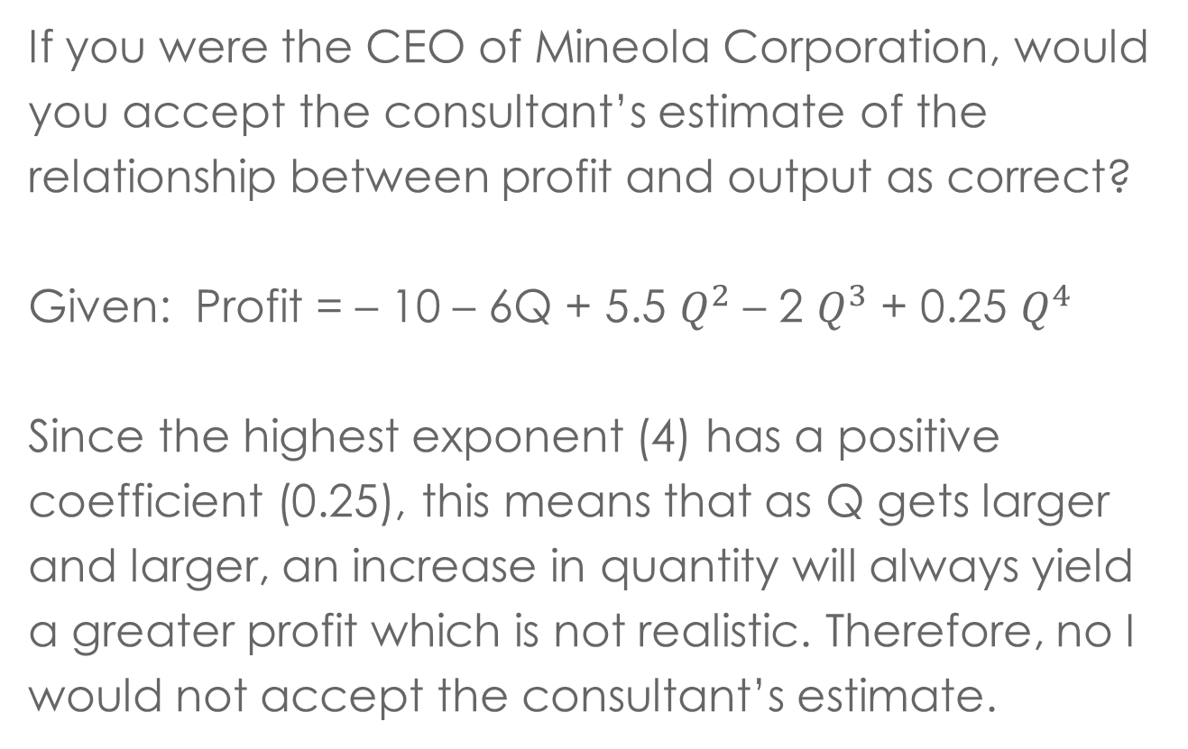
QUESTION / SOLUTION 8c
If you were the CEO of Mineola Corporation, would you accept the consultant’s estimate of the relationship between profit and output as correct?
Given: Profit = – 10 – 6Q + 5.5 $Q^{2}$ – 2 $Q^{3}$ + 0.25 $Q^{4}$
Since the highest exponent (4) has a positive coefficient (0.25), this means that as Q gets larger and larger, an increase in quantity will always yield a greater profit which is not realistic. Therefore, no I would not accept the consultant’s estimate.

Slide 40
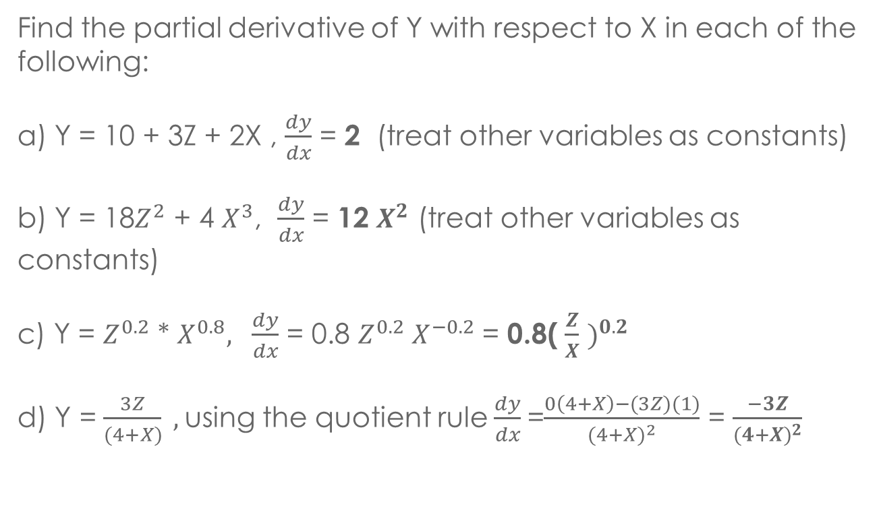
QUESTION / SOLUTION 9
Find the partial derivative of Y with respect to X in each of the following:
a) Y = 10 + 3Z + 2X , $\frac{dy}{dx}$ = 2 (treat other variables as constants)
b) Y = 18$Z^{2}$ + 4 $X^{3}$, $\frac{dy}{dx}$ = 12 $X^{2}$ (treat other variables as constants)
c) Y = $Z^{0.2}$ * $X^{0.8}, \frac{dy}{dx}$ = 0.8 $Z^{0.2} X^{−0.2}$ = 0.8( $\frac{Z}{X}$ $)^{0.2}$
d) Y = $\frac{3Z}{(4+X)} ,$using the quotient rule$\frac{dy}{dx}$ =$\frac{0\left(4+X\right)−(3Z)(1)}{{(4+X)}^{2}}$ = $\frac{−3Z}{{(4+X)}^{2}}$

Slide 41
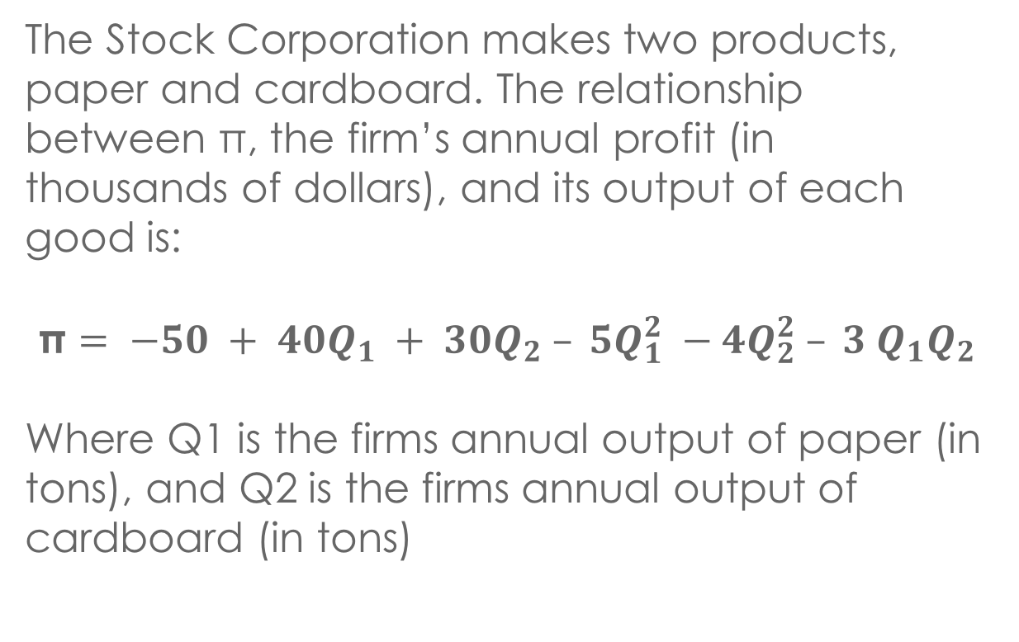
QUESTION 10
The Stock Corporation makes two products, paper and cardboard. The relationship between $\text{π}$, the firm’s annual profit (in thousands of dollars), and its output of each good is:
$$\text{π}= −50 + 40Q_{1} + 30Q_{2} – 5Q_{1}^{2} −4Q_{2}^{2} – 3 Q_{1}Q_{2}$$
Where Q1 is the firms annual output of paper (in tons), and Q2 is the firms annual output of cardboard (in tons)

Slide 42
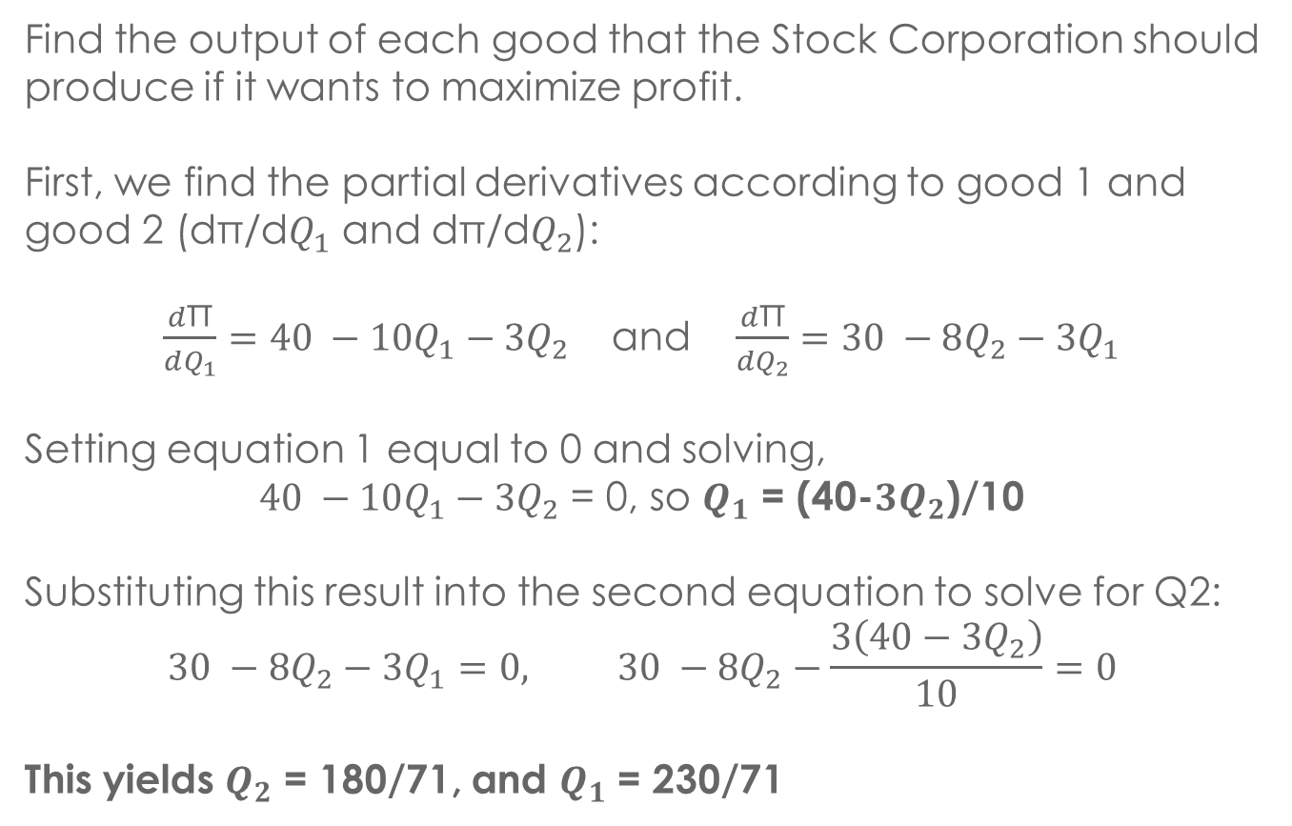
QUESTION / SOLUTION 10a
Find the output of each good that the Stock Corporation should produce if it wants to maximize profit.
First, we find the partial derivatives according to good 1 and good 2 (dπ/d$Q_{1}$ and dπ/d$Q_{2}$):
$\frac{d\text{π}}{dQ_{1}}=40 −10Q_{1}−3Q_{2}$ and $\frac{d\text{π}}{dQ_{2}}=30 −8Q_{2}−3Q_{1}$
Setting equation 1 equal to 0 and solving,
$40 −10Q_{1}−3Q_{2}$ = 0, so $Q_{1}$ = (40-$3Q_{2}$)/10
Substituting this result into the second equation to solve for Q2:
$$30 −8Q_{2}−3Q_{1}=0, 30 −8Q_{2}−\frac{3\left(40−3Q_{2}\right)}{10}=0$$
This yields $Q_{2}$ = 180/71, and $Q_{1}$ = 230/71

Slide 43
QUESTION / SOLUTION 10b
If the community imposes a tax of $5,000 per year on the firm, will this alter the answer to Part a? If so, how will the costs change?
The economic answer to this is since the tax is independent of quantity (Q), it will not affect the profit-maximizing output since all output levels will have a decreased profit of the same amount. Therefore, profit is still maximized at the same Q₁ and Q₂ found before
The mathematical answer is we are simply subtracting $5,000 from our profit equation. When we take the derivative, the $5,000 disappears (it’s a constant) so we get the same answer.

Slide 44
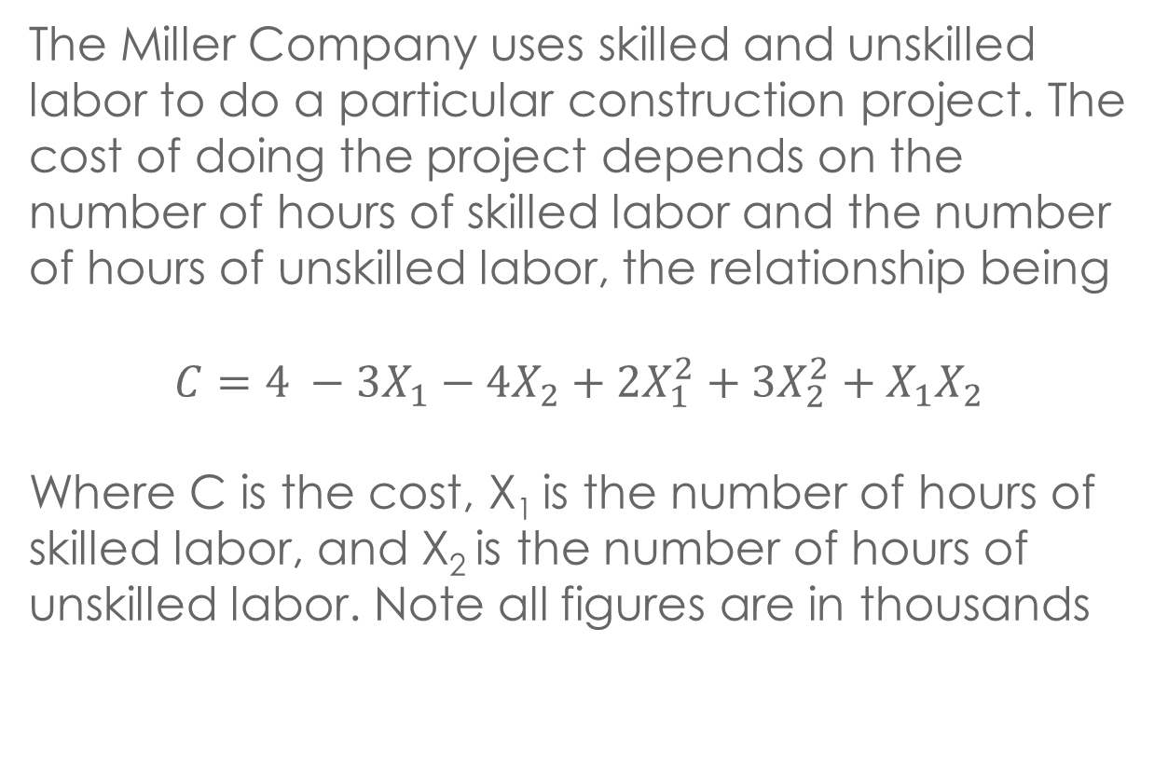
QUESTION 11
The Miller Company uses skilled and unskilled labor to do a particular construction project. The cost of doing the project depends on the number of hours of skilled labor and the number of hours of unskilled labor, the relationship being
$$C=4 −3X_{1}−4X_{2}+2X_{1}^{2}+3X_{2}^{2}+X_{1}X_{2}$$
Where C is the cost, X₁ is the number of hours of skilled labor, and X₂ is the number of hours of unskilled labor. Note all figures are in thousands

Slide 45
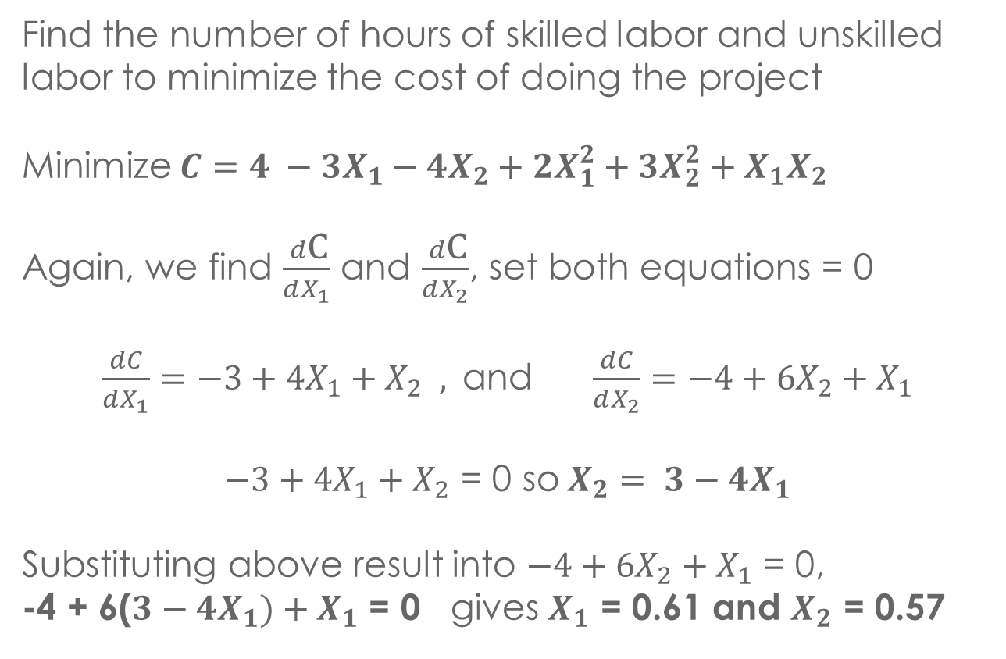
QUESTIONS / SOLUTION 11a
Find the number of hours of skilled labor and unskilled labor to minimize the cost of doing the project
Minimize $C=4 −3X_{1}−4X_{2}+2X_{1}^{2}+3X_{2}^{2}+X_{1}X_{2}$
Again, we find $\frac{d\text{C}}{dX_{1}}$ and $\frac{d\text{C}}{dX_{2}}$, set both equations = 0
$\frac{dC}{dX_{1}}=−3+4X_{1}+X_{2} ,$and $\frac{dC}{dX_{2}}=−4+6X_{2}+X_{1}$
$−3+4X_{1}+X_{2}$ = 0 so$X_{2}= 3−4X_{1}$
Substituting above result into $−4+6X_{2}+X_{1}$ = 0,
-4 + 6($3−4X_{1})+X_{1}$ = 0 gives $X_{1}$ = 0.61 and $X_{2}$ = 0.57

Slide 46
QUESTION / SOLUTION 11b
If the Miller Company has to purchase a license costing $2,000 to do this project, will this alter the answer to Part a?
Similar to 10b, no, since this fee is independent of hours of skilled/unskilled, it has no effect on the number of hours chosen to minimize cost.
Mathematically, this is like adding $2,000 to the cost function. It has no effect on the derivatives, because the derivative of a constant is zero. Thus, the values of X₁ and X₂ that minimize the cost function remain the same.

Slide 47
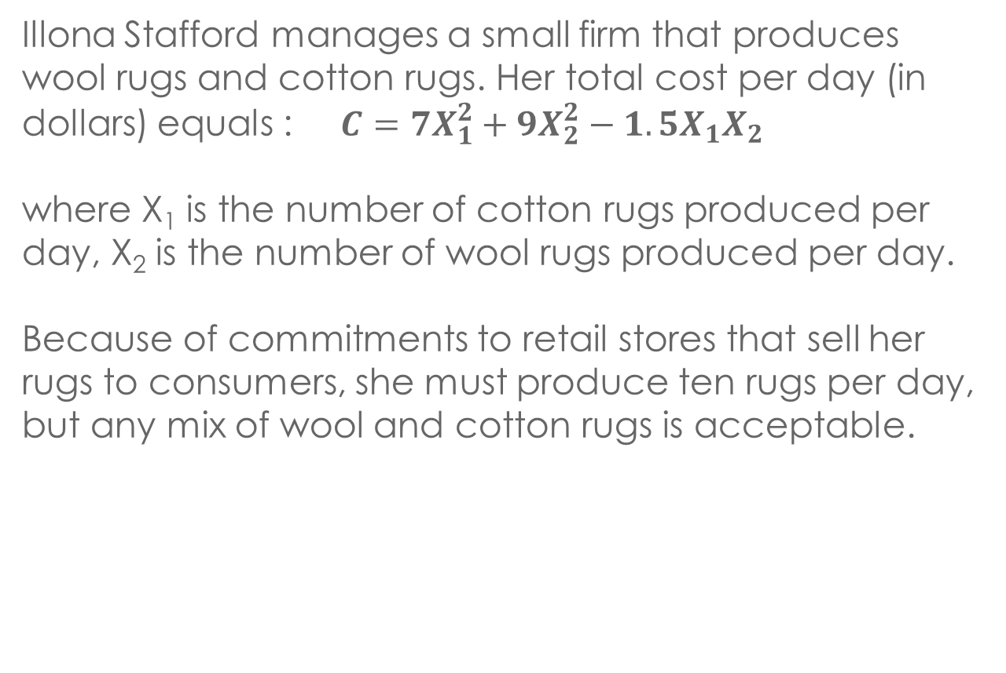
QUESTION 12
Illona Stafford manages a small firm that produces wool rugs and cotton rugs. Her total cost per day (in dollars) equals :$C=7X_{1}^{2}+9X_{2}^{2}−1.5X_{1}X_{2}$
where X₁ is the number of cotton rugs produced per day, X₂ is the number of wool rugs produced per day.
Because of commitments to retail stores that sell her rugs to consumers, she must produce ten rugs per day, but any mix of wool and cotton rugs is acceptable.

Slide 48
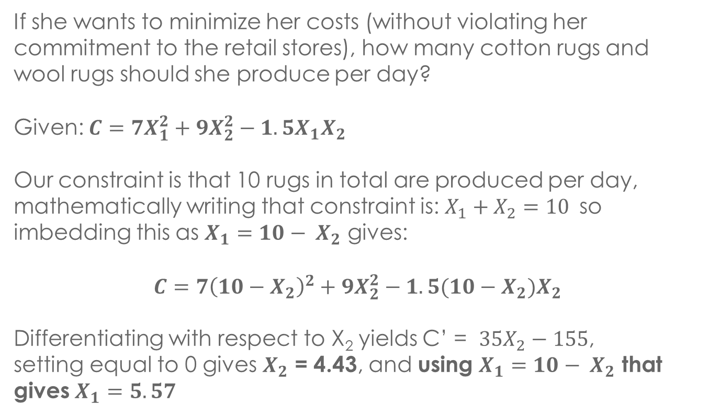
QUESTION / SOLUTION 12
If she wants to minimize her costs (without violating her commitment to the retail stores), how many cotton rugs and wool rugs should she produce per day?
Given: $C=7X_{1}^{2}+9X_{2}^{2}−1.5X_{1}X_{2}$
Our constraint is that 10 rugs in total are produced per day, mathematically writing that constraint is: $X_{1}+X_{2}=10$so imbedding this as $X_{1}{=10− X}_{2}$ gives:
$$C=7{\left(10−X_{2}\right)}^{2}+9X_{2}^{2}−1.5(10−X_{2})X_{2}$$
Differentiating with respect to X₂ yields C’ = $35X_{2}−155$,
setting equal to 0 gives $X_{2}$ = 4.43, and using $X_{1}{=10− X}_{2}$ that gives $X_{1}=5.57$

Slide 49
QUESTION / SOLUTION 12
b) Does it seem reasonable that she would want to minimize costs in a situation of this sort? Why or why not?
Generally, this is not reasonable as she should maximize profit. At her minimum cost, her revenue might be low as well (implying a smaller profit), but at a greater cost, revenue could be proportionally greater (implying a larger profit). She would want to maximize profit rather than minimizing cost.

Slide 50
QUESTION / SOLUTION 12
c) Can she produce fractional numbers of rugs per day?
Depending on the schedule in which she ships rugs to stores, production of fractional rugs may be possible.
For instance, if she ships rugs every 7 days, this implies that she produces 39 cotton rugs (5.57 rugs/day * 7 days) and 31 wool rugs (4.43 rugs/day * 7 days) every 7 days. This totals 70 rugs (31+39) over 7 days, which complies to the 10 rug/day (70 rugs/7 days) production constraint.

Slide 51
ADDITIONAL RESOURCES
This video covers basic differentiation rules:
https://www.youtube.com/watch?v=esxNDR1epeo
This video cover a basic optimization problem with a constraint:
https://www.youtube.com/watch?v=Zq7g1nc2MJ8

Slide 52
Q & A

